Slide 1

Tutor App
By,
Chandhana Menon
1NH17CS712

Slide 2
What is Tutor App ?
Tutor app is a small scale application that is primararily built for tutors to keep a track of all the students and their respective batches details. It also manages the fee payment details of the students, of different batches as well.
Frontend- Python3
Backend- MySQL

Slide 3
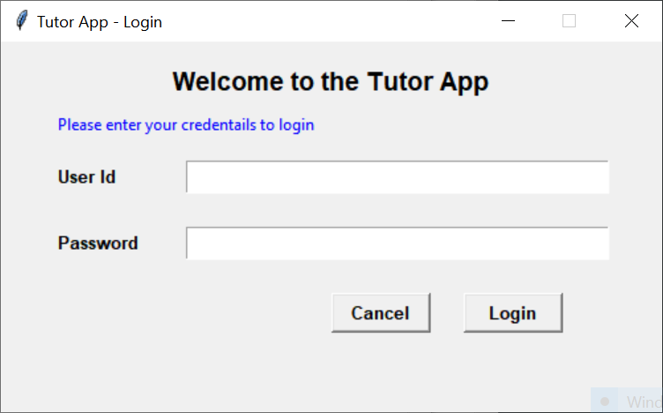
Login Page For Admin

Slide 4
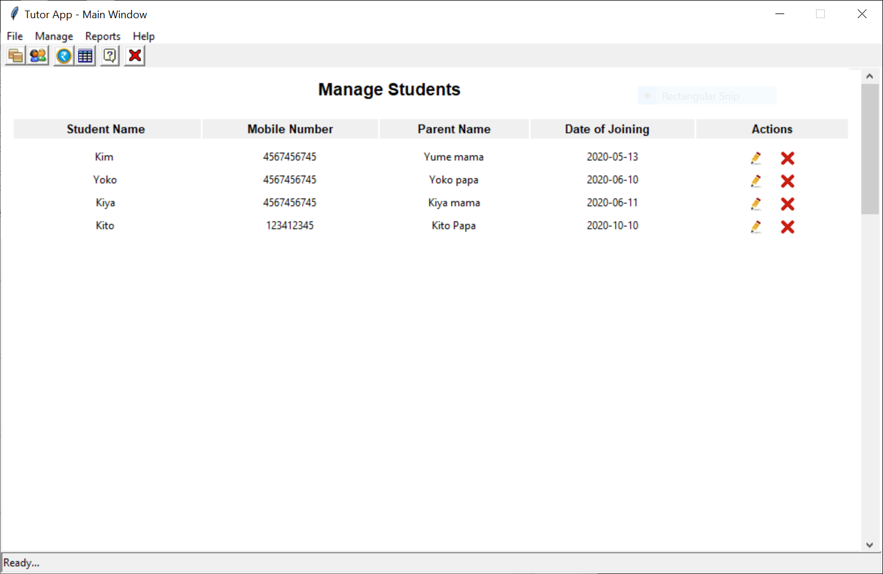
Display Students

Slide 5
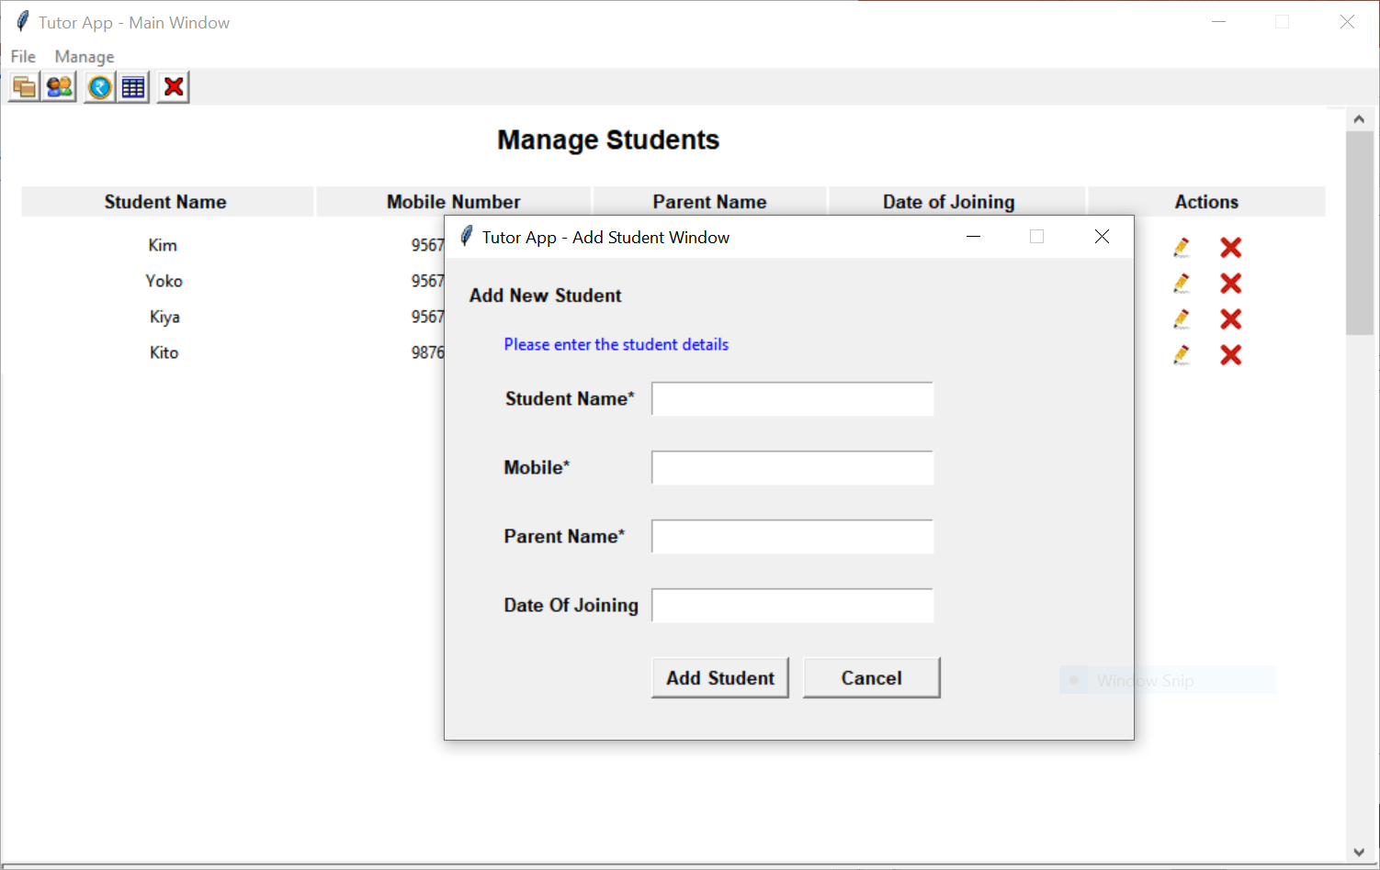
Add New Student Information

Slide 6
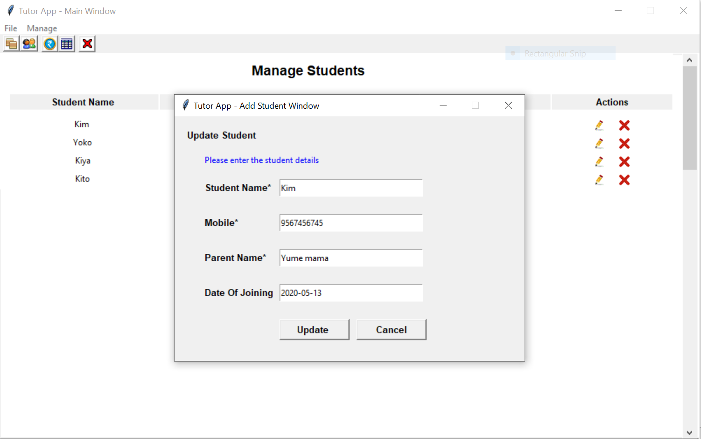
Update Student Information

Slide 7
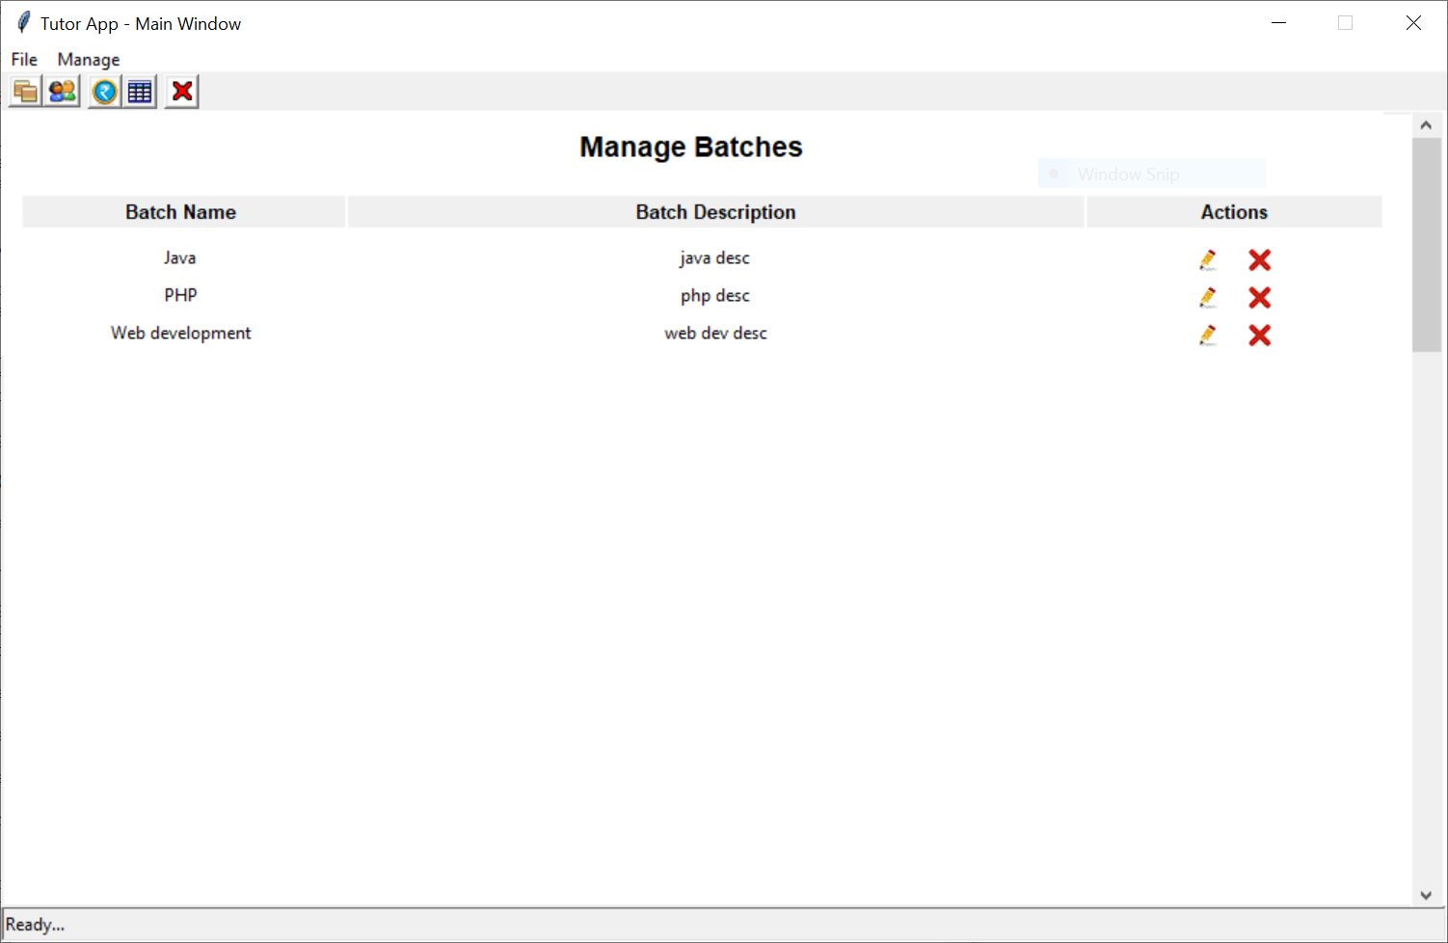
Display Batches

Slide 8
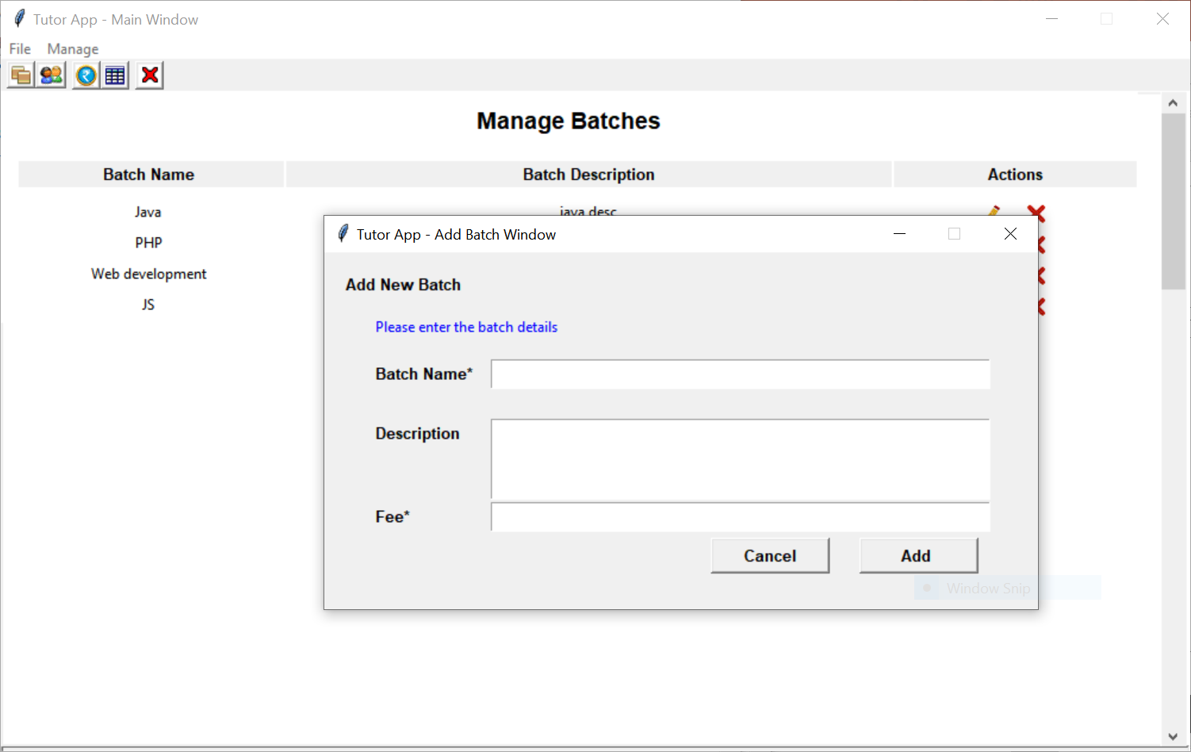
Add New Batch Infomtion

Slide 9
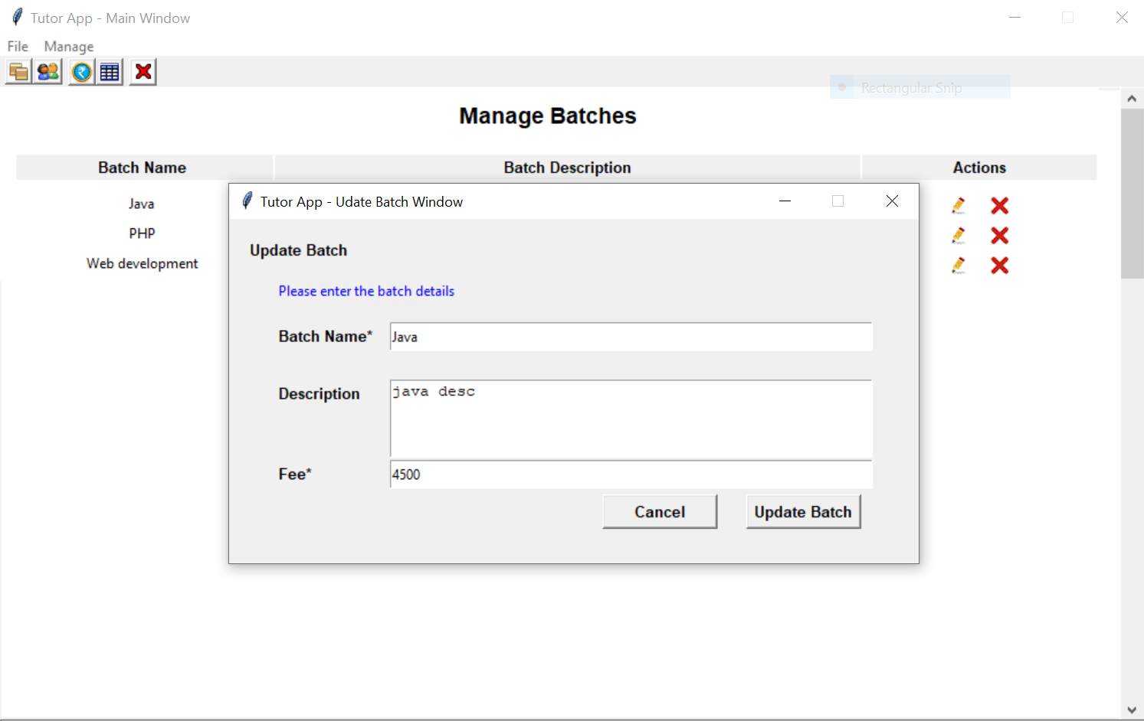
Update Batch Details

Slide 10
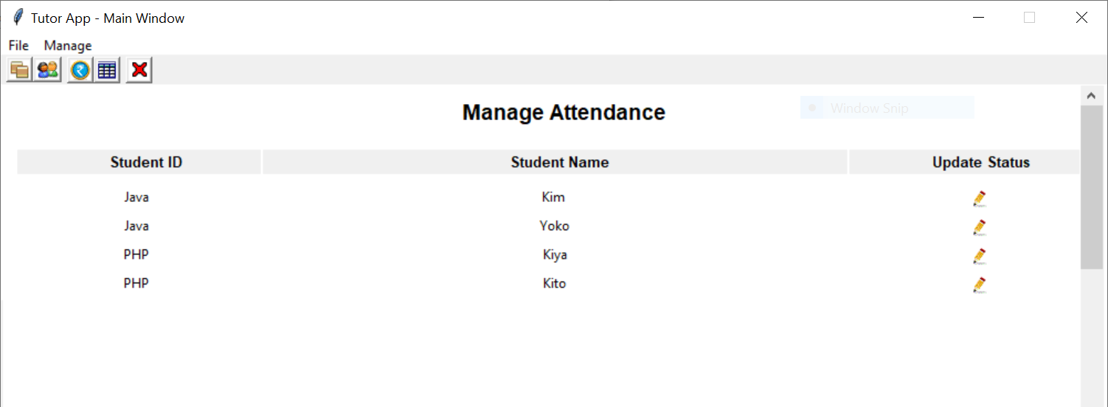
Attendance List

Slide 11
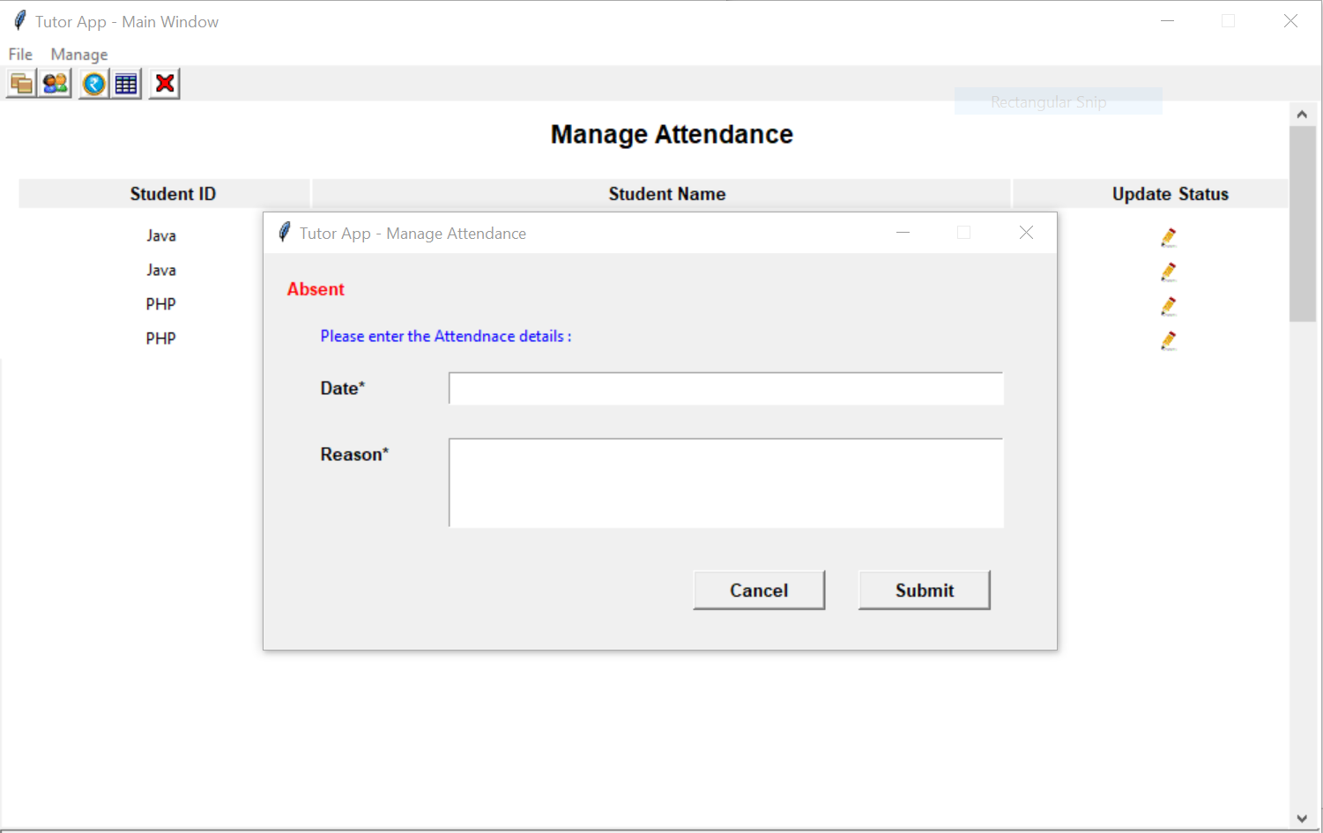
Attendance Information

Slide 12
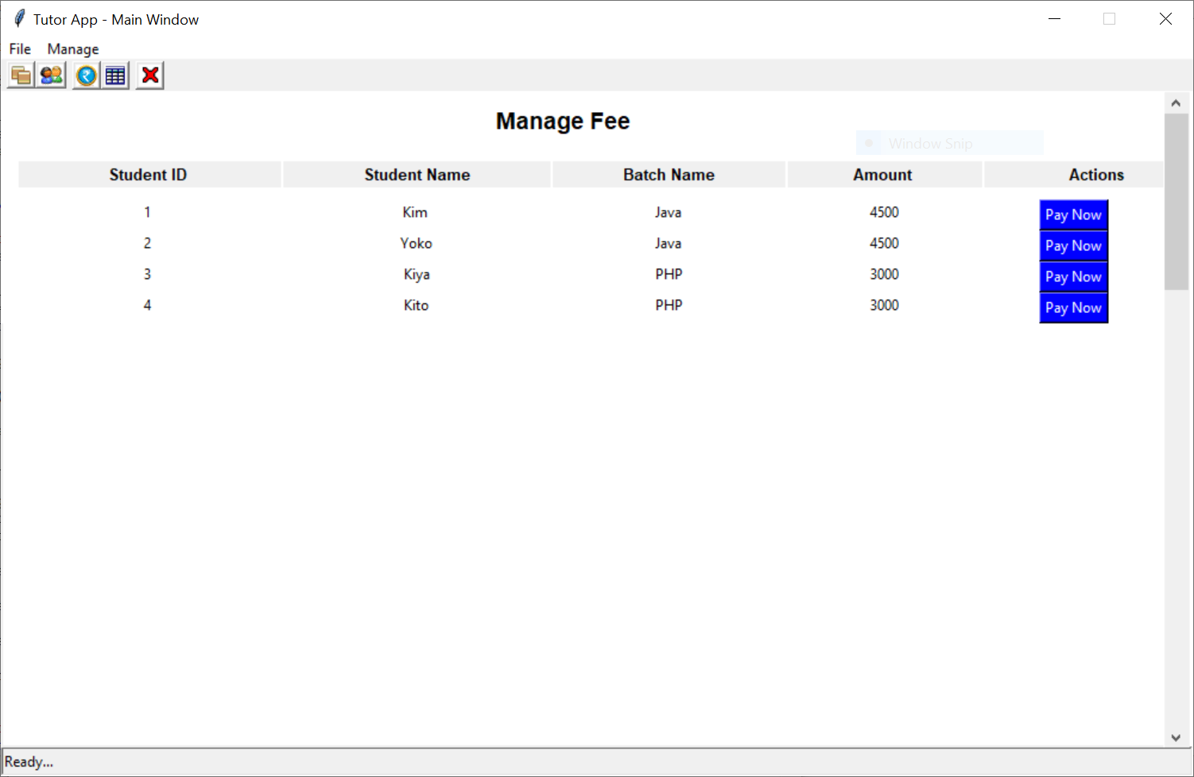
Fee Information

Slide 13
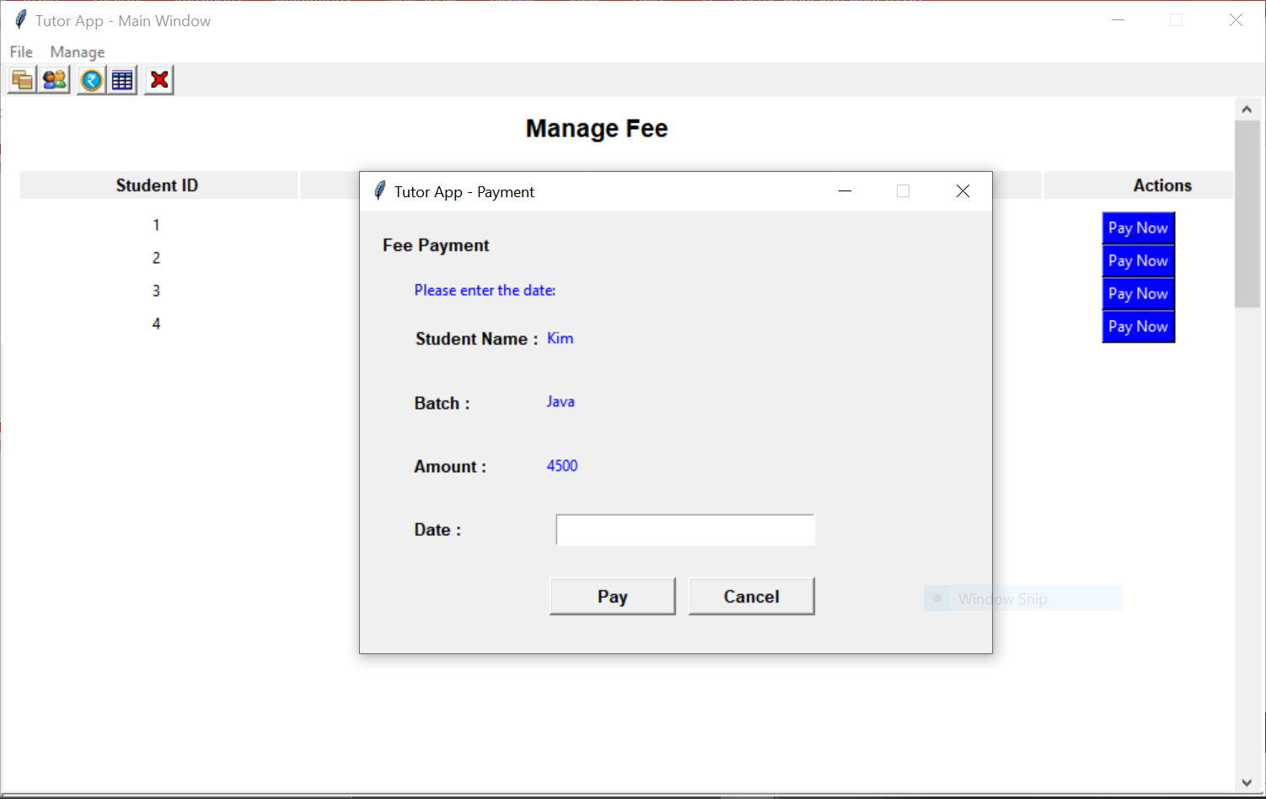
Fee Payment

Slide 14
Thank you

